Slide 1
Unit 3 Homeostasis and Disease
Chapter 2
Chemical Messengers

Slide 2
Endocrine vs Exocrine Systems
The products of exocrine glands secrete into a duct that carries the secretion to the surface of the body eg sweat, mucus and saliva.
Hormones, the products of the endocrine system are secreted into the extracellular fluid that surrounds the ducts, pass through into nearby capillaries and are transported around the body in the blood.

Slide 3
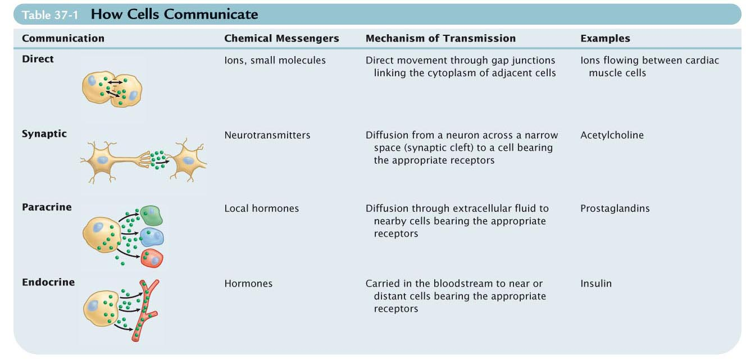
Four methods of cell-to-cell communication are found in the human body, ranging from direct to remote communication.

Slide 4
Overview of the Endocrine System
It helps maintain homeostasis in the body.
It is a system of ductless glands that secrete hormones
  Hormones are “messenger molecules”
  Circulate in the blood
  Act on distant target cells
  Target cells respond to the hormones for which they have receptors
  The effects are dependent on the programmed response of the target cells
  Hormones are just molecular triggers

Slide 5
Hormones
Hormones are secreted by the endocrine system and are transported around the body in the blood.
Hormones have a target cell (or group of target cells) which have the correct receptor protein. So hormones are specific. Lock and key analogy can be used.
Saturation can occur. More hormones = more activity only until all the receptors are “full”.
Different types of cells have different types and numbers of receptor cells so they can respond to different hormones and perform specific tasks.

Slide 6
Hormones can:
activate certain genes so that particular proteins (including enzymes) can be formed
turn an enzyme “on” or “off” by changing its shape
change the rate of production of an enzyme or other protein by changing the rate of transcription and translation (protein synthesis)
activate production of thousands of enzymes - enzyme amplification. Thus a small stimulus can have a very large effect.

Slide 7
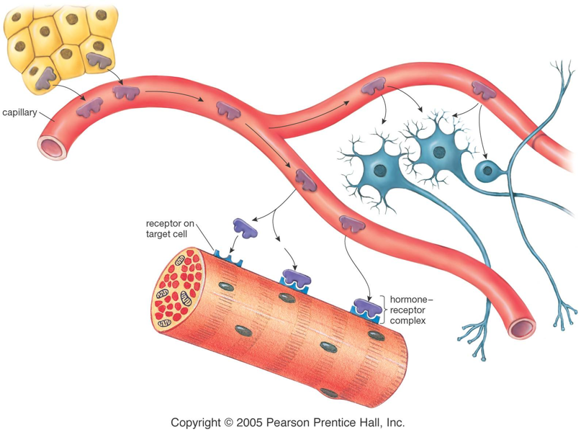
Hormones and Receptors

Slide 8
Control of hormone secretions
Negative feedback systems regulate the production of hormones. The regulating factors come from the hypothalamus.
for example:
The body responds to a stimulus
The hypothalamus secretes releasing factors which stimulate the production and release of a hormone
The body now has sufficient hormone levels (which is another stimulus)
The hypothalamus secretes inhibiting factors which slow down the production and release of the hormone.

Slide 9
Negative Feedback Loop
  Stimulus →
  receptor detects change →
  sends message →
  response initiated →
  stimulus changes
  https://vimeo.com/78090182

Slide 10
Basic categories of hormones
  Amino acid based: modified amino acids (or amines)
  Proteins (long chains of amino acids) and peptides (short chains of amino acids)
  Steroids: lipid molecules derived from cholesterol

Slide 11
Amine and Protein Hormones
They are water soluble so cannot pass through a cell membrane.
They attach to a receptor protein in the cell membrane which causes a secondary messenger substance to diffuse through the cytoplasm and activate a particular enzyme/protein.

Slide 12
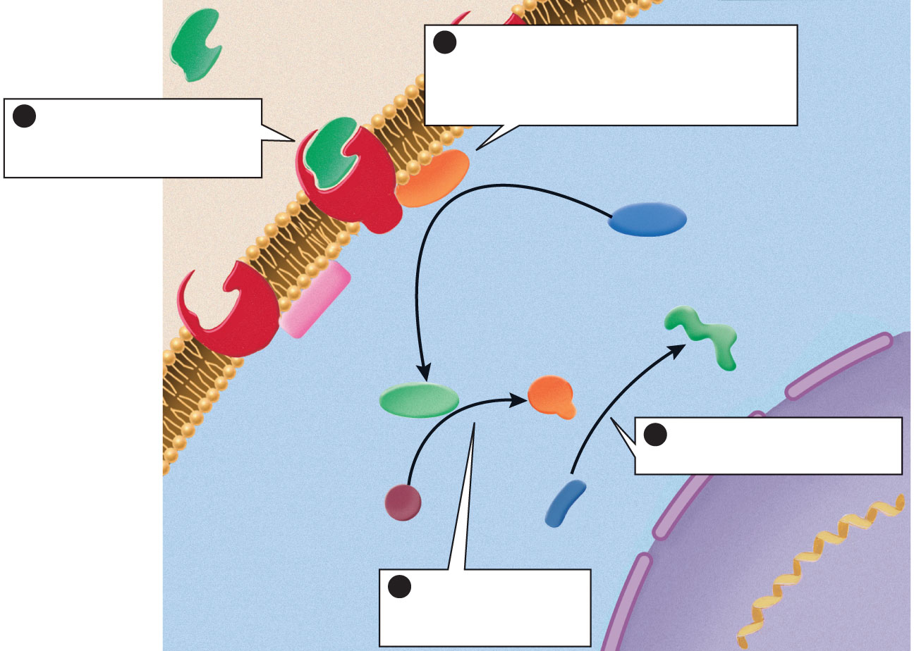
peptide or amino
acid-derived
hormone
(first messenger)
2
Hormone–receptor binding
activates an enzyme that catalyzes
the synthesis of a second messenger,
such as cyclic AMP
1
The hormone binds to
a receptor on the plasma
membrane of a target cell
cyclic AMP-
synthesizing
enzyme
(cytoplasm)
(extracellular
fluid)
ATP
active
enzyme
receptor
product
cyclic AMP
(second messenger)
4
The activated enzymes
catalyze specific reactions
plasma membrane
inactive
enzyme
reactant
3
The second
messenger activates
other enzymes
nuclear
envelope
(nucleus)

Slide 13
Steroid hormones
They are lipid soluble so can directly pass through the cell membrane.
The hormone enters the target cell and combines with a receptor protein inside the cell, often in the nucleus or mitochondria, sometimes other organelles.
The hormone-receptor complex then activate the genes that control the transcription and translation of a particular protein.

Slide 14
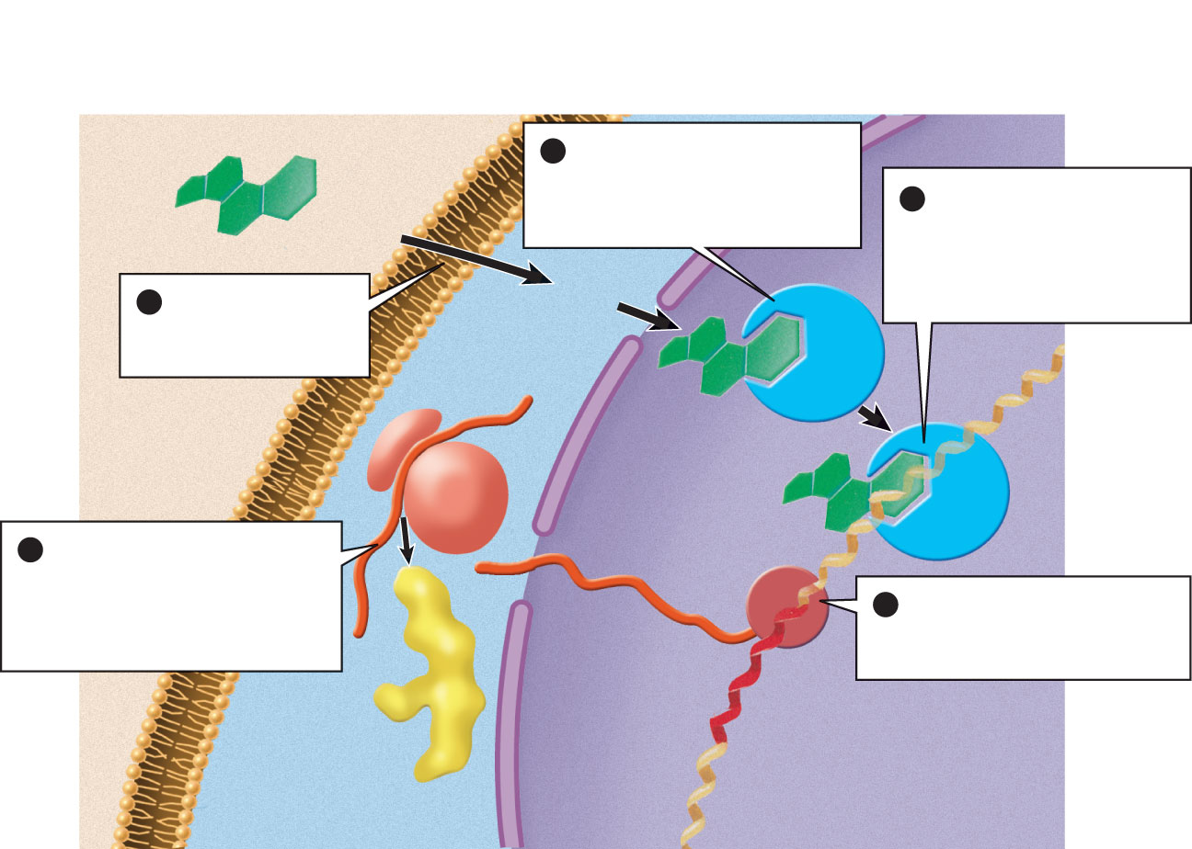
steroid hormone
(extracellular
fluid)
2
The hormone binds to a
receptor in the nucleus or to
a receptor in the cytoplasm
that carries it into the nucleus
3
The hormone–receptor
complex binds to DNA and
causes RNA polymerase to
bind to a nearby promoter
site for a specific gene
1
A steroid hormone
diffuses through the
plasma membrane
plasma
membrane
DNA
hormone receptor
ribosome
5
The mRNA leaves the
nucleus, then attaches to a
ribosome and directs the
synthesis of a specific protein
product
RNA polymerase
4
RNA polymerase catalyzes
the transcription of DNA into
messenger RNA (mRNA)
mRNA
new protein
gene
nuclear
envelope
(cytoplasm)
(nucleus)

Slide 15
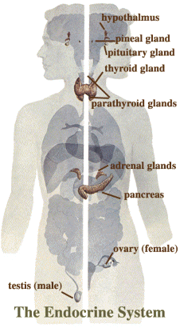
Major Glands of the Endocrine System
Pituitary Gland
  Anterior and Posterior
Pineal Gland
Hypothalamus
Thyroid Gland
Parathyroid
Thymus
Adrenal Gland
  Adrenal Cortex
  Adrenal Medulla
Pancreas
Testes
Ovaries

Slide 16
Hypothalamus
Location: at the base of the brain, below the thalamus;
Primary Hormones: No one specific hormone; called the “gate-keeper” regulating the release and inhibition of hormones
“Gate-keeper” role; regulates pituitary gland and acts as the link between our nervous system and endocrine system.

Slide 17
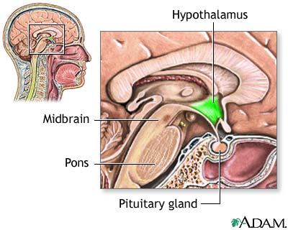

Slide 18
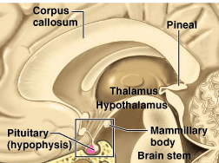
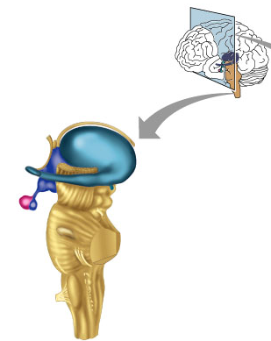
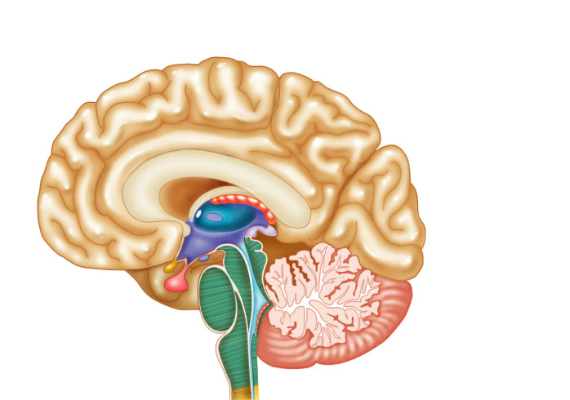
Hypothalamus__
Anterior pituitary__
_____________Posterior pituitary
Hypothalamus___________
Pineal gland
Pituitary__________
(hypophysis)

Slide 19
Pituitary Gland
Location: Posterior to the hypothalamus
Major Disorders: dwarfism, gigantism, Diabetes encephalis

Slide 20
Role of the Pituitary
The pituitary is the “master gland” that signals other glands to produce their hormones when needed.
The anterior lobe of the pituitary receives signals from the hypothalamus, and responds by sending out the appropriate hormone to other endocrine glands.
The posterior pituitary receives oxytocin or antidiuretic hormone (ADH) from the hypothalamus, relays them to the body as necessary.

Slide 21
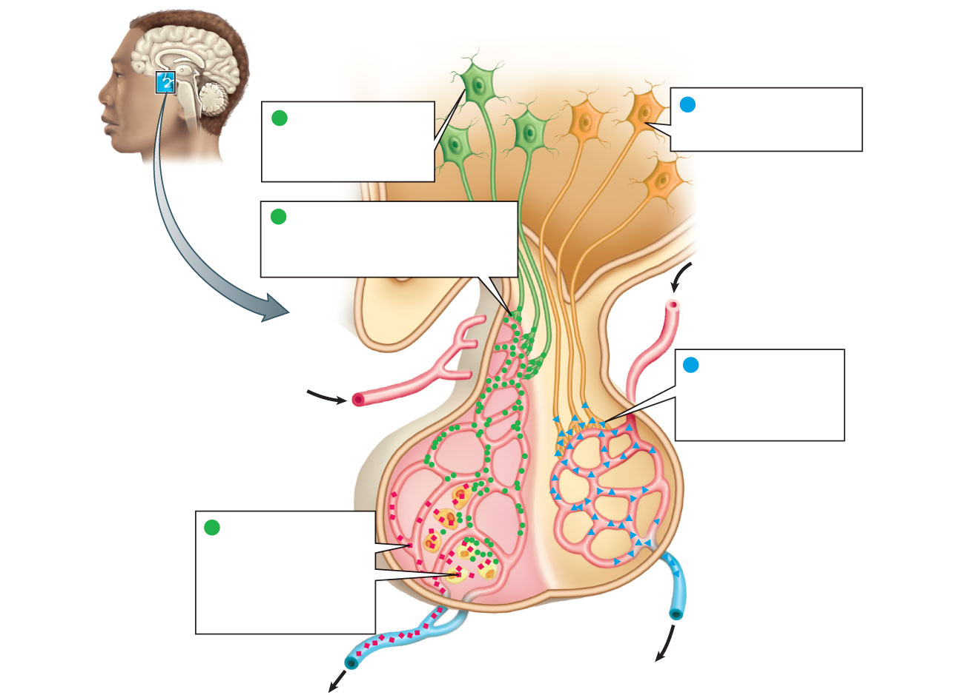
hypothalamus
Neurosecretory cells of
the hypothalamus produce
oxytocin and ADH
Neurosecretory cells
of the hypothalamus
produce releasing and
inhibiting hormones
1
1
Releasing or inhibiting hormones
(green circles) are secreted into
capillaries feeding the anterior lobe
of the pituitary
2
2
Oxytocin and ADH
(blue triangles) are
secreted into the blood
via capillaries in the
posterior pituitary
blood flow
pituitary
(anterior lobe)
endocrine
cell
capillary
bed
pituitary
(posterior lobe)
Endocrine cells of the
anterior pituitary secrete
hormones (red squares)
in response to releasing
hormones; the pituitary
hormones enter the
bloodstream
3
capillary
bed
blood
flow

Slide 22
Pituitary Hormones
Pituitary Hormone | Functions
Follicle-stimulating hormone | Stimulates egg maturation in the ovary and release of sex hormones.
Lutenizing hormone | Stimulates maturation of egg and of the corpus luteum surrounding the egg, which affects female sex hormones and the menstrual cycle.
Thyroid-stimulating hormone | Stimulates the thyroid to release thyroxine.
Adrenocorticotropic hormone | Causes the adrenal gland to release cortisol.
Melanocyte-stimulating hormone | Stimulates synthesis of skin pigments.
Growth hormone | Stimulates growth during infancy and puberty.
Antidiuretic hormone | Signals the kidney to conserve more water.
Oxytocin | Affects childbirth, lactation, and some behaviors.

Slide 23
Pineal Gland
Location: Between the pons and sides of the thalamus; size of a pea
Primary Hormones: Melatonin
Functions: Regulates sleep patterns; mating patterns; migration patterns; day and night rhythms
Major Disorders: Insomnia

Slide 24
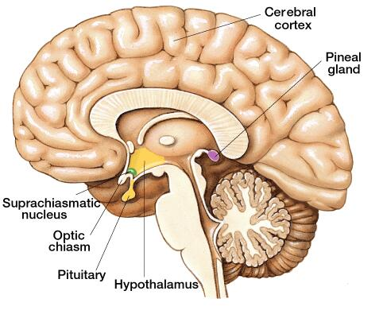

Slide 25
Thyroid Gland
Location: Anterior region of neck, surrounding trachea
Primary Hormones: Thyroxine (T-4) and Triiodothyronine (T-3)
Functions: Regulate iodine; secrete TSH (thyroid stimulating hormone)
Major Disorders: Goiter; Thyroid Cancer

Slide 26
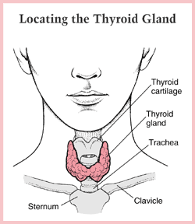

Slide 27
Parathyroid Gland
Location: 4 glands around the thyroid
Primary Hormones: PTH (parathyroid hormone)
Functions: Affects the bones and kidneys; maintain calcium levels in the blood
Major Disorders: Osteoporosis; Hyper- and Hypo- parathyroidism

Slide 28
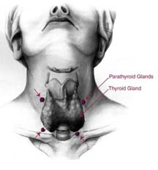

Slide 29
Thymus
Location: Thoracic cavity below the neck;
Primary Hormones: Thymosis;
Functions: T-lymphocyte education center
Major Disorders: Cancers (lymphomas)

Slide 30
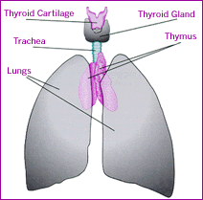

Slide 31
Adrenal Gland
Adrenal Cortex
Location: Atop the kidneys; outer layer surrounding the adrenal medulla
Primary Hormones: Glococorticoids, Mineralcorticoids, and Aldosterone
Functions: Maintain blood pressure, metabolism, levels of estrogen and testosterone
Major Disorders: Addison’s disease and Cushing’s disease

Slide 32
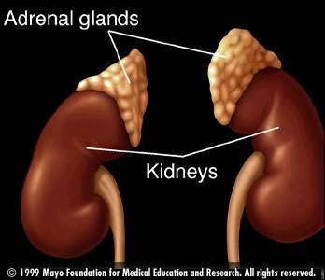
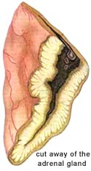

Slide 33
Adrenal Gland
Adrenal Medulla
Location: Atop the kidneys surrounded by the adrenal cortex; the adrenal pulp
Primary Hormones: Epinephrine and Norepinephrine (a.k.a. Adrenaline)
Functions: Increase blood pressure, heart rate, dialation of pupils (adrenaline rush)
Major Disorders: Pheochromocytoma

Slide 34
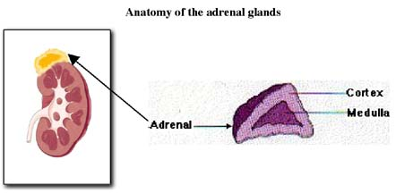
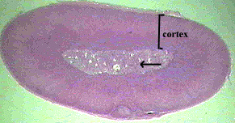

Slide 35
Pancreas
Location: Around the stomach and small intestine
Primary Hormones: Insulin and Glucagon (secreted by the pancreatic islets or the Islets of Langerhans)
Functions: Digestion of enzymes; regulate blood-glucose levels; insulin uptake
Major Disorders: Diabetes mellitus types I and II

Slide 36
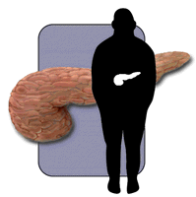
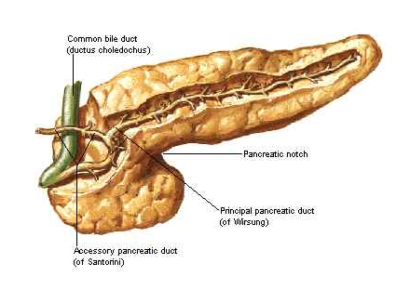

Slide 37
Testes
Location: Within the scrotum
Primary Hormones: Testosterone; ICSH
Functions: Produce sperm and testosterone; primary and secondary sex characteristics
Major Disorders: Testicular cancer; Germ-cell tumors

Slide 38
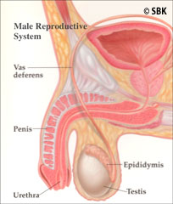

Slide 39
Ovaries
Location: In the abdomen at the end of the fallopian tubes
Primary Hormones: Estrogen, Progestins, Estradiol
Functions: Produce female gametes; ova and ovum; oocytes- immature gametes
Major Disorders: Ovarian Cancer;

Slide 40
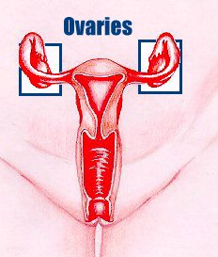
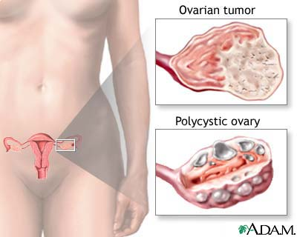

Slide 41
Endocrine Hormones
Gland | Hormones | Functions
Thyroid | Thyroxine | Regulates metabolism
 | Calcitonin | Inhibits release of calcium from the bones
Parathyroids | Parathyroid hormone | Stimulates the release of calcium from the bones.
Islet cells (in the pancreas) | Insulin | Decreases blood sugar by promoting uptake of glucose by cells.
 | Glucagon | Increases blood sugar by stimulating breakdown of glycogen in the liver.
Testes | Testosterone | Regulates sperm cell production and secondary sex characteristics.
Ovaries | Estrogen | Stimulates egg maturation, controls secondary sex characteristics.
 | Progesterone | Prepares the uterus to receive a fertilized egg.
Adrenal cortex | Epinephrine | Stimulates “fight or flight” response.
Adrenal medulla | Glucocorticoids | Part of stress response, increase blood glucose levels and decrease immune response.
 | Aldosterone | Regulates sodium content in the blood.
 | Testosterone (in both sexes) | Adult body form (greater muscle mass), libido.
Pineal gland | Melatonin | Sleep cycles, reproductive cycles in many mammals.

